Slide 1
Welcome to
Math & Logic!
With Ruth Carlson

Slide 2
Review: What did we do in class last time?
Review: What binary number comes before 101?
What binary number comes after 101?
Preview: In a function, each input has _______ ___ output.
Notes:
Review: Solve Linear Inequality Applications, Inequality Logical Decisions, remember to flip the inequality whenever you multiply or divide by a negative number.
Review: 100, 110
Preview: exactly one

Slide 3
Algebra
Competency: Solve applied algebraic problems
Functions

Slide 4
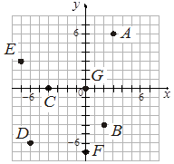
Relations
Ordered pairs
Cartesian plane
Notes:
Ordered Pairs have an x-coordinate and a y-coordinate, (x, y) The Cartesian Plane is divided into 4 quadrants by the x-axis and the y-axis.

Slide 5
Relations
A set of ordered pairs is a relation.
Notes:
Is this relation a function? No, because points G and F are on the same vertical line. They have the same x-coordinates but different y-coordinates.

Slide 6
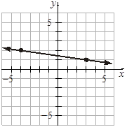
Functions
Solutions to this equation.
x + 7y = 10
Notes:
Is this a function?
Yes, there are not two points that have the same x-coordinates but different y-coordinates.

Slide 7
Functions
Which points are solutions to the equation?
3x + y = 12 (0, 0)
(-2, 18)
(4, 0)
(6, 6)
Notes:
(-2, 18) makes the equation true and (4, 0) makes the equation true

Slide 8
Functions
A function is a particular type of relation in which each input produces exactly one output.
Notes:
All chihuahuas are dogs, but not all dogs are chihuahuas. All functions are relations, but not all relations are functions.

Slide 9
Functions
Function Notation:
name(argument) = output
f(x) = 2x
g(x) = x + 4
Notes:
f is the name of the first function. f has an argument (or input) of x and produces the output 2x. g is the name of the second function. g has an argument (or input) of x and produces the output x + 4.

Slide 10

Functions
Function Notation:
name(argument) = output
f(x) = 2x f(8) = 16 (8, 16) y = 2x
g(x) = x + 4 g(0) = 4 (0, 4) y = x + 4
Notes:
y = f(x)

Slide 11
Functions
Given f(x) = x² - 5, find the indicated values.
f(3)
f(10)
f(a)
f(3b)
Notes:
f(3) = 9 - 5 = 4, f(10) = 100 - 5 = 95, f(a) = a^2 - 5, f(3b) = (3b)^2 - 5 = (3b)*(3b) - 5 = 9b^2 - 5

Slide 12
Functions
Given k(x) = 3x² - 8, find the indicated values.
k(0)
k(-1)
k(4m)
k(5p¹⁰)
Notes:
k(0) = 3*0^2-8 = 3*0-8 = 0-8 = -8, k(-1) = 3*(-1)^2-8 = 3*1-8 = 3-8 = -5, k(4*m) = 3*(4*m)^2-8 = 3*16*m^2-8 = 48*m^2-8, k(5p^10) = 3*(5*p^10)^2-8 = 3(25*p^20)-8 = 75*p^20-8

Slide 13

Functions
Given , find the indicated values.
h(12)
h(45)
h(a + 1)
h(a² + 21)
Notes:
Is sqrt(a^2 + 25) the same as a + 5? Strategy: Solve a simpler case. Ask: Is this true? 3 + 4 = sqrt(9 + 16)

Slide 14
Functions
Some functions are defined piecewise using different output formulas for different inputs.
Notes:
You may see these when you do your taxes! If the input is this, then do that. If the input is this other thing, then do that other thing, etc. Notice the non-overlapping inputs.

Slide 15

Functions
Given the function
find the indicated values.
f(1)
f(10)
f(0)
Notes:
f(1) = 3, f(10) = 2*10 -1 = 19, f(0) = 0 + 3 = 3

Slide 16
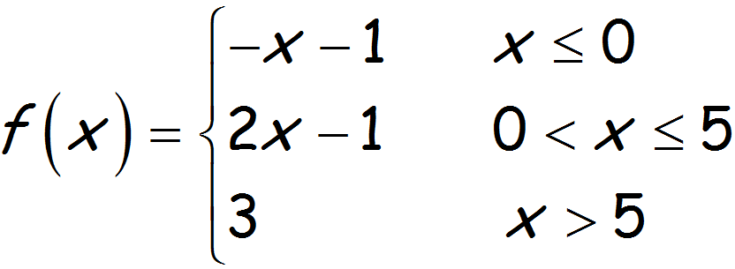
Functions
Given the function
find the indicated values.
f(66)
f(5)
f(0)
Notes:
f(66) = 3, f(5) = 2*5 - 1 = 9, f(0) = 0 - 1 = -1

Slide 17
Functions
Let’s practice!
Notes:
See Practice Functions and videos in Canvas.

Slide 18
Review
Functions

Slide 19
To Do:
Functions
Crash Course 07
Crash Course 08

Slide 20
Have a great day!
And remember that every day
at CVTC is a great day!

